Slide 1
An interactive topic model to uncover the hidden structure in Social media mental health data
By, Supervisor,
Muthukumar Rajendran Dr. Evangelos E. Milios
(B00835091)

Slide 2
Presentation Overview
Fall, 2020
Fall, 2020
Fall, 2020
Nov, 2020 to 2021
Social media Dataset
Exploratory data analysis
Directed Study Project
EDA Tool

Slide 3
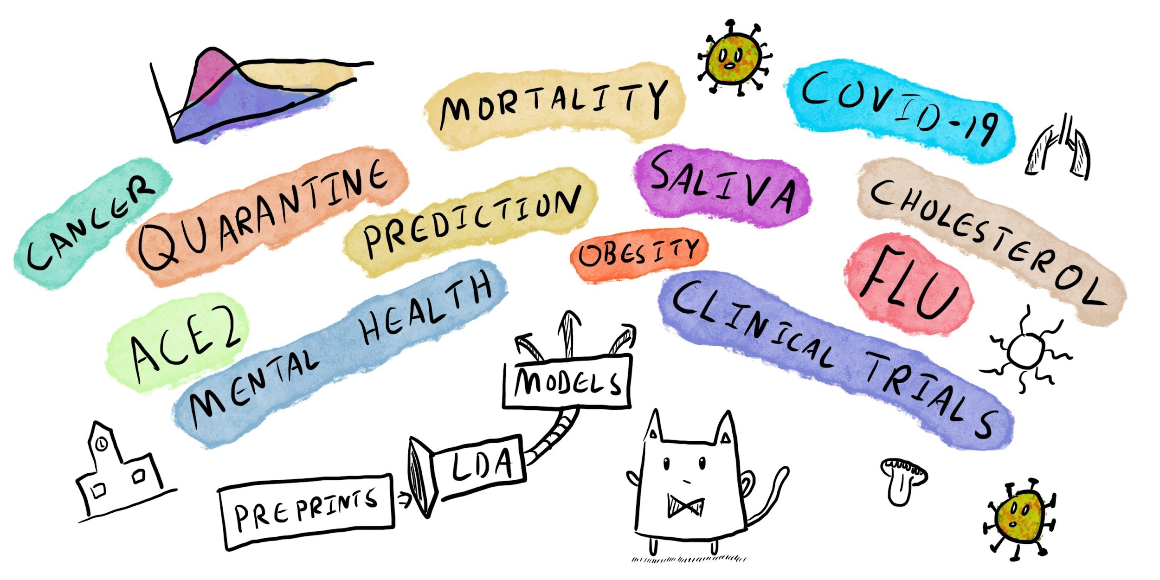
Directed Study Project - Motivation

Slide 4
Dataset Used
Social Media
Twitter
Reddit
Collected using Twitter API
Twitter data from Kaggle
Pre-covid
Post-covid

Slide 5
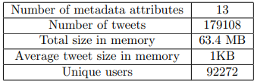
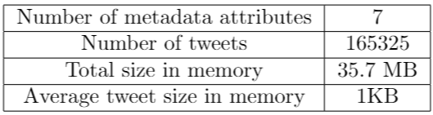
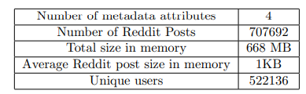
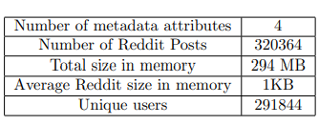
EDA Analysis
Twitter Kaggle Dataset 2020
Data Statistics:
Twitter Data 2020 PreCovid Reddit Data PostCovid Reddit Data

Slide 6
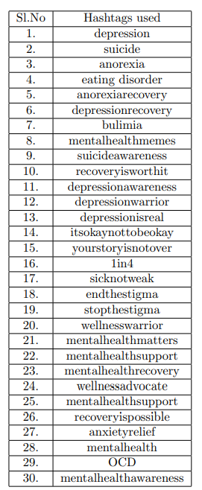
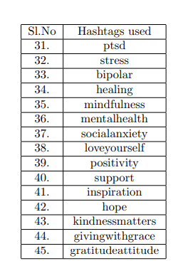
Hashtags used
The hashtags that are used for extracting the dataset is found in the following links,
https://yourtangoexperts.com/mental-health-hashtags-depression-hashtags-anxiety-hashtags-instagram-twitter/
https://psychcentral.com/blog/mental-health-hashtag-list/

Slide 7
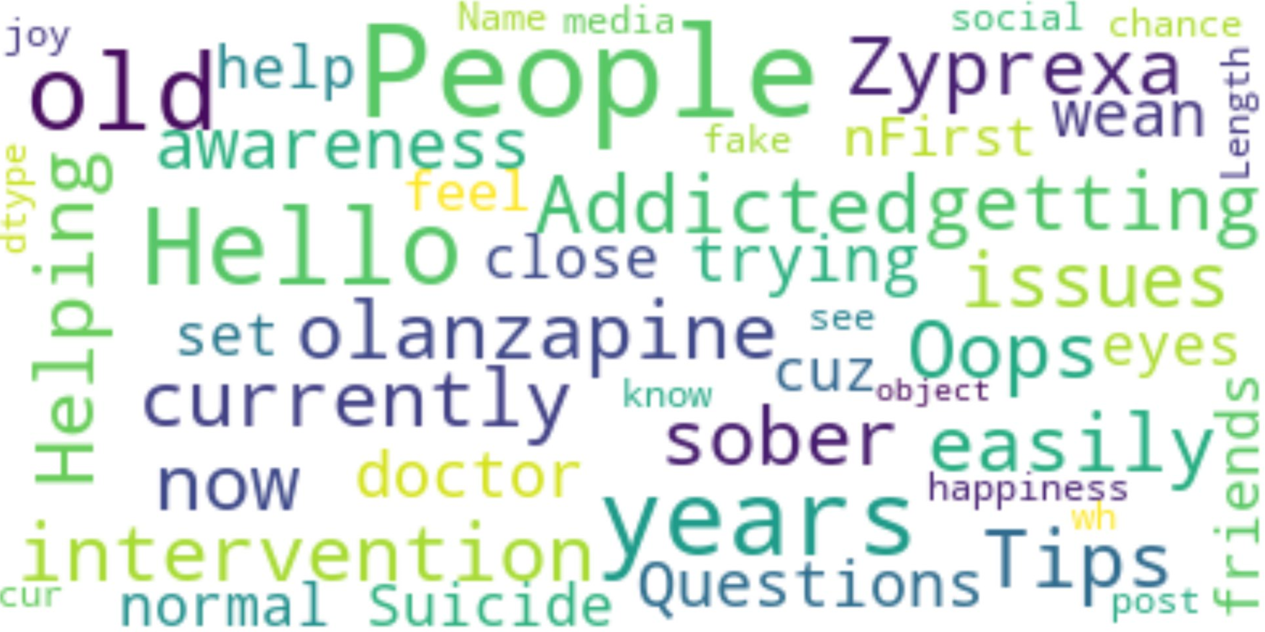
Word-clouds
Word clouds formed for,
Each month in a dataset,
For the whole year in the dataset.
Word cloud before covid,
Word cloud after covid

Slide 8
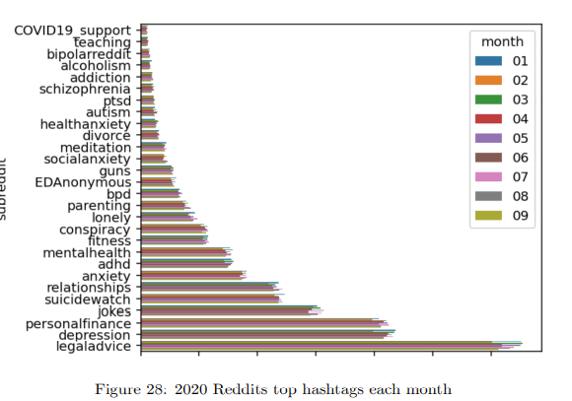
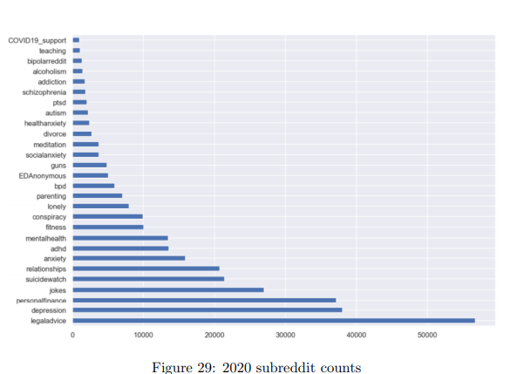
Top hashtags used in Reddit 2020 data
01-Jan
02-Feb
03-Mar
04-Apr
05-May
06-Jun
07-July
08-Aug
09-Sep

Slide 9
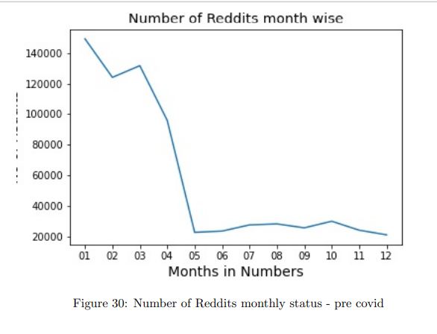
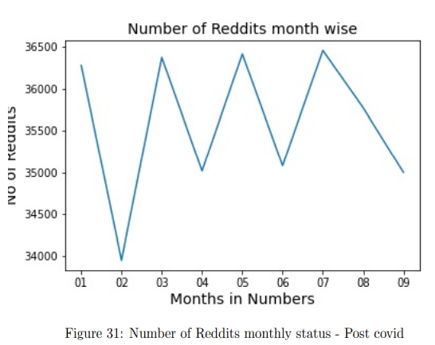
Number of Reddit posts month wise
01-Jan
02-Feb
03-Mar
04-Apr
05-May
06-Jun
07-July
08-Aug
09-Sep
10-Oct
11-Nov
12-Dec
01-Jan
02-Feb
03-Mar
04-Apr
05-May
06-Jun
07-July
08-Aug
09-Sep

Slide 10
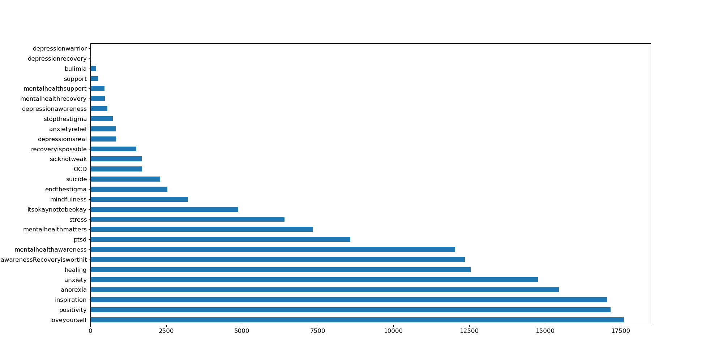
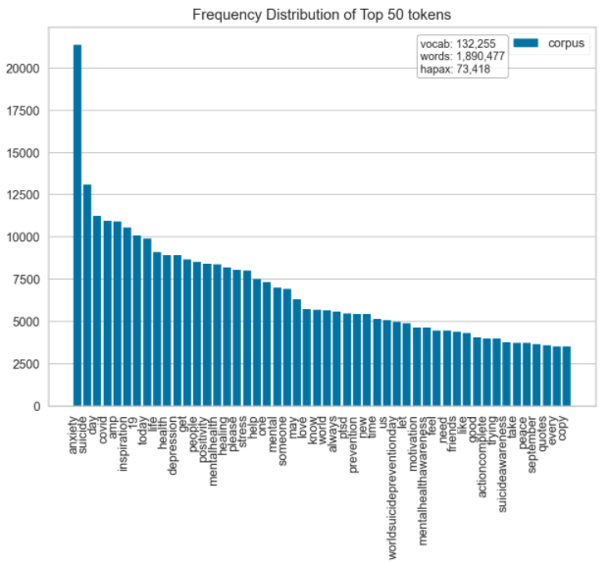
2020 tweets hashtag counts
01-Jan
02-Feb
03-Mar
04-Apr
05-May
06-Jun
07-July
08-Aug
09-Sep
10-Oct
11-Nov
12-Dec

Slide 11
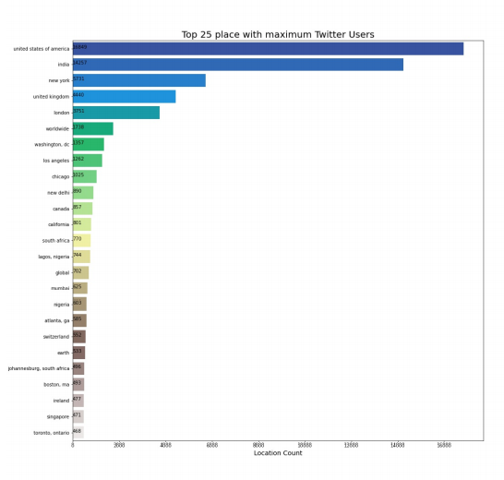
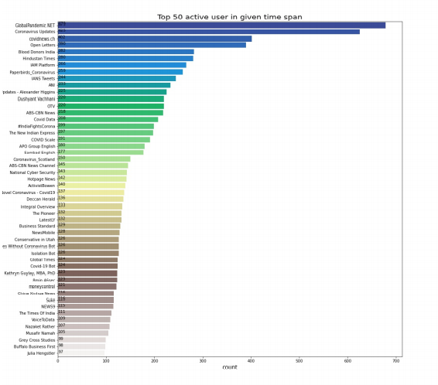
Most active users and countries in twitter

Slide 12
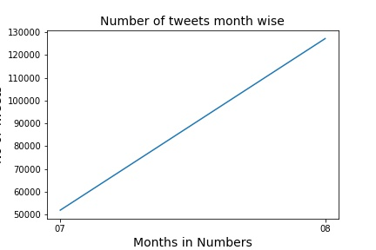
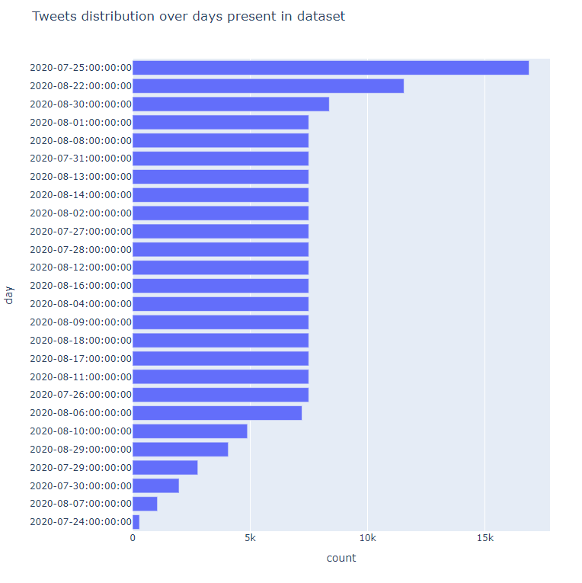
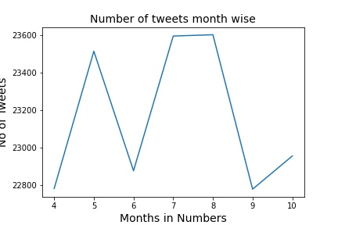
No. of tweets month wise
04-Apr
05-May
06-Jun
07-July
08-Aug
09-Sep
10-Oct
Twitter Data 2020
Twitter Data Kaggle 2020

Slide 13
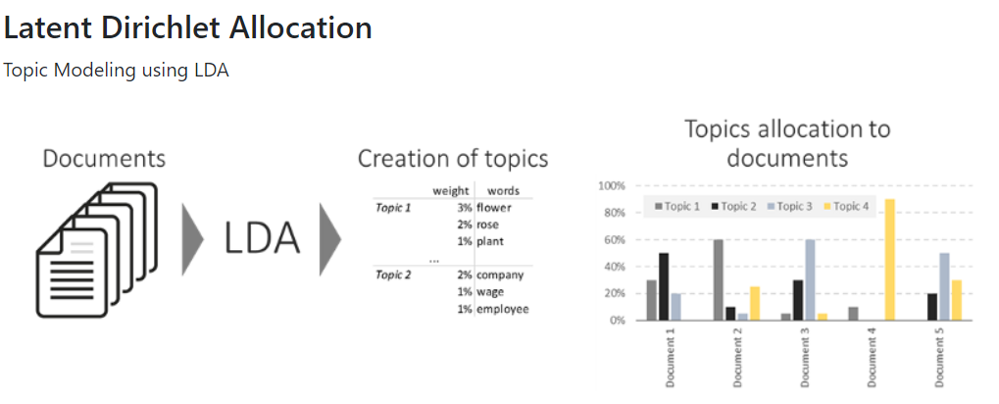
What would help us?

Slide 14
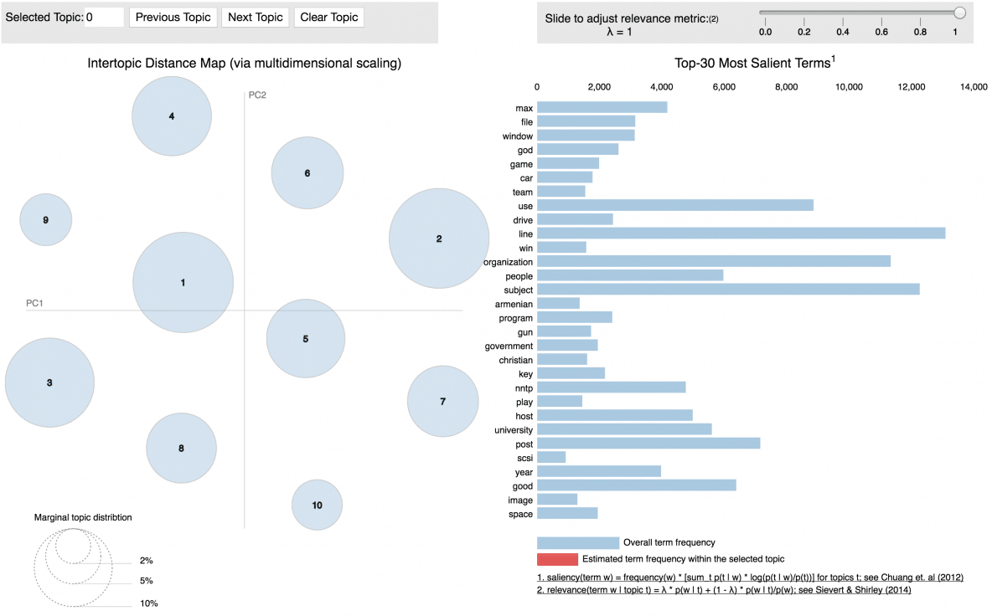
Interactive Visualization - pyLDAvis

Slide 15
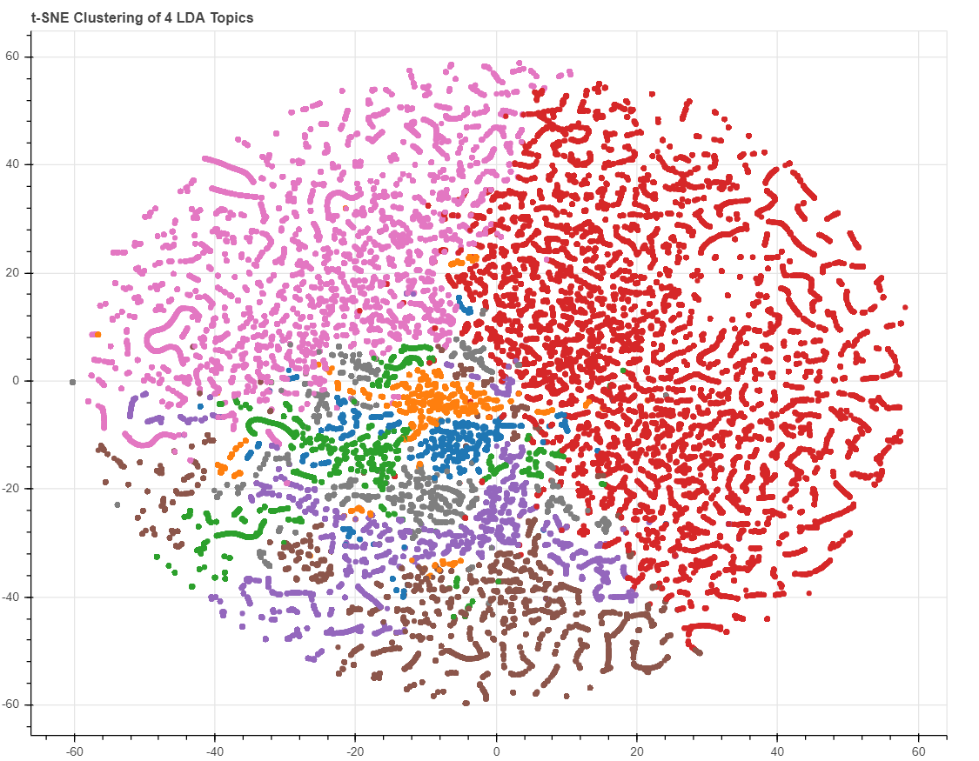
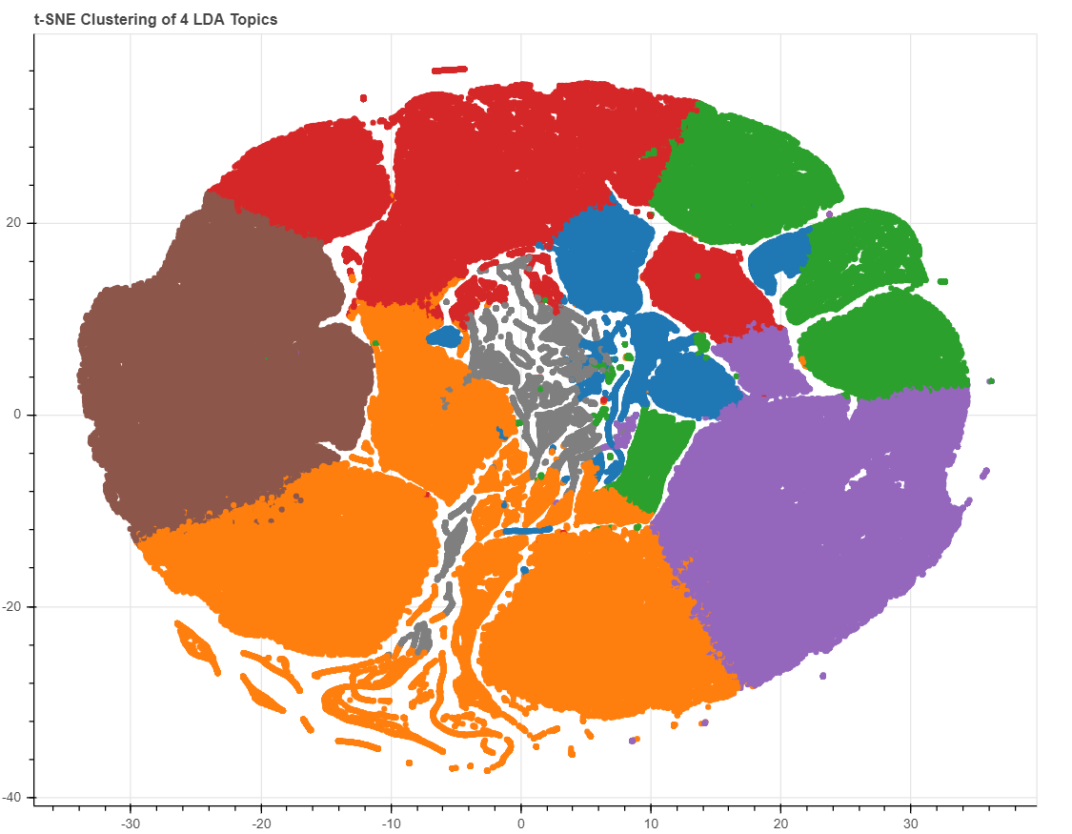
Results
Twitter topic clouds
Reddit topic clouds
Twitter topic clouds

Slide 16
EDA Analysis Tool
The EDA analysis tool that we have designed will help us analyze words-clouds.
It also helps us to analyze the amount of topics spoken about a particular hashtag year-wise as well as month wise.

Slide 17
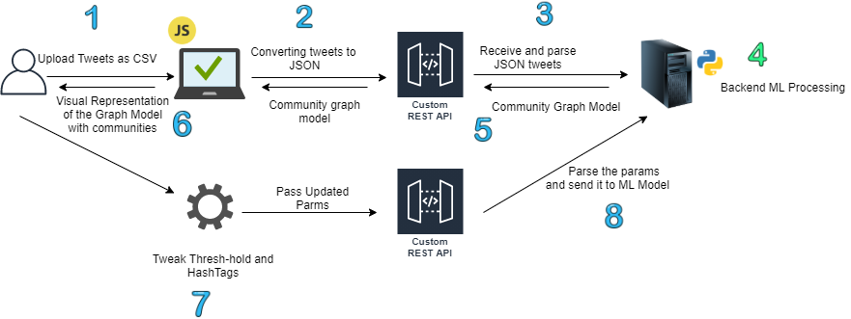
Design architecture

Slide 18
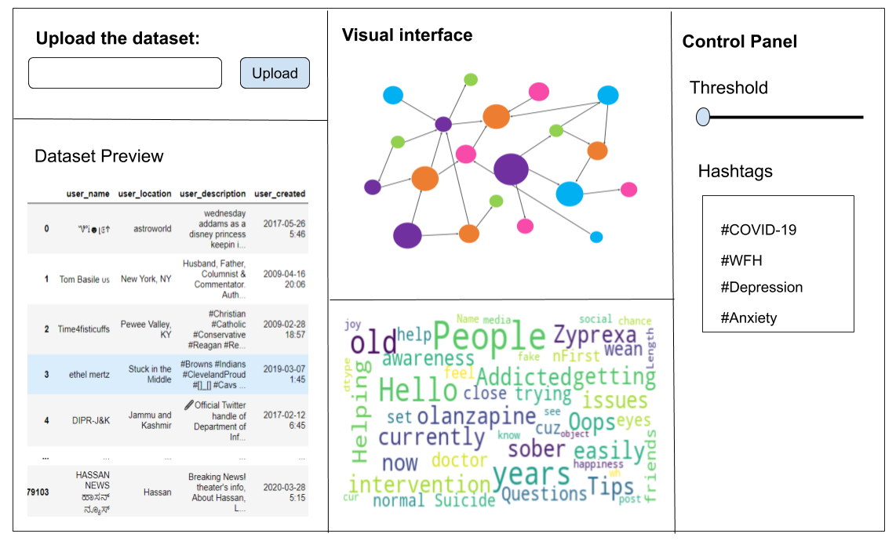
Interactive visual interface

Slide 19
EDA Tool Future implements
A tool that is generic for all the datasets.
To implement data summarization technique.
Allow user to choose between different summarization and clustering techniques.

Slide 20
Thanks!

